Slide 1
Lecture 3: Introduction to Parallel Computing Using CUDA
IEEE Boston Continuing Education Program
Ken Domino, Domem Technologies
May 16, 2011

Slide 2
Announcements
Course website updates:
PDF http links fixed.
Lecture3 – http://domemtech.com/ieee_pp/Lecture3.pptx
Counting 6’s – http://domemtech.com/ieee_pp/c6_better.zip
Ocelot working
Installation guide – http://domemtech.com/ieee_pp/Ocelot.{pdf,docx}

Slide 3
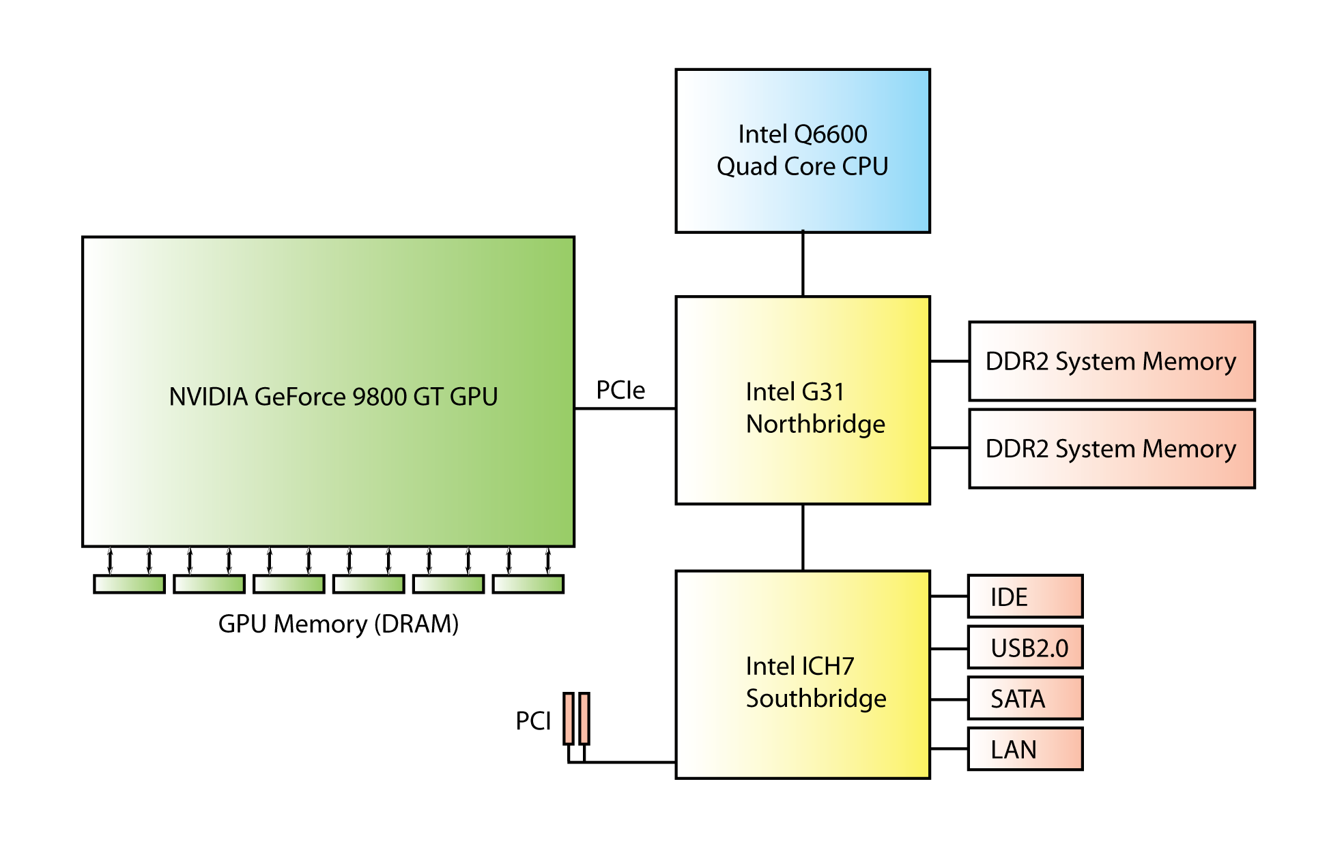
GPU is a coprocessor for CPU
Master
Slave

Slide 4
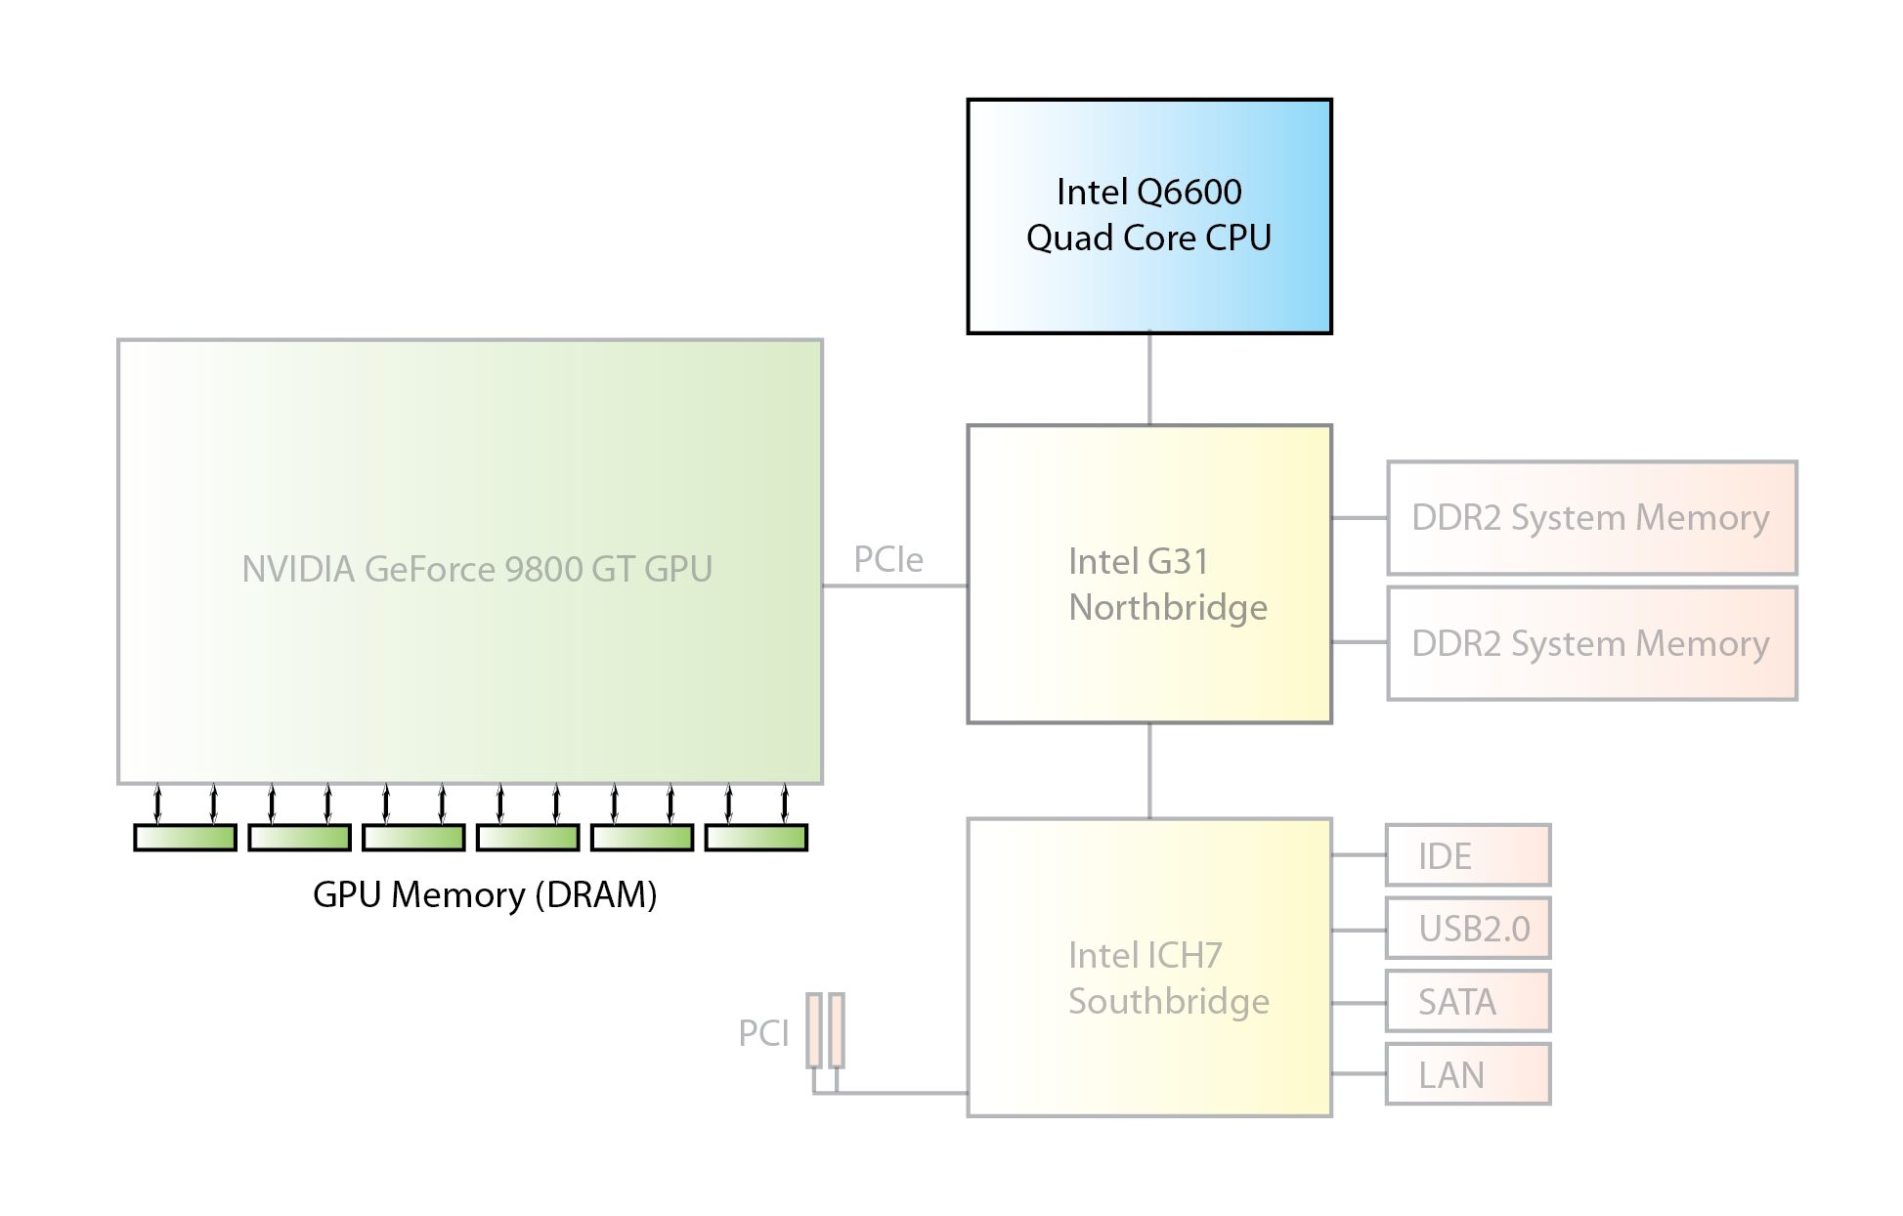
CUDA Runtime API
cudaMalloc(&d, len)
0
1
2
…
len - 1

Slide 5
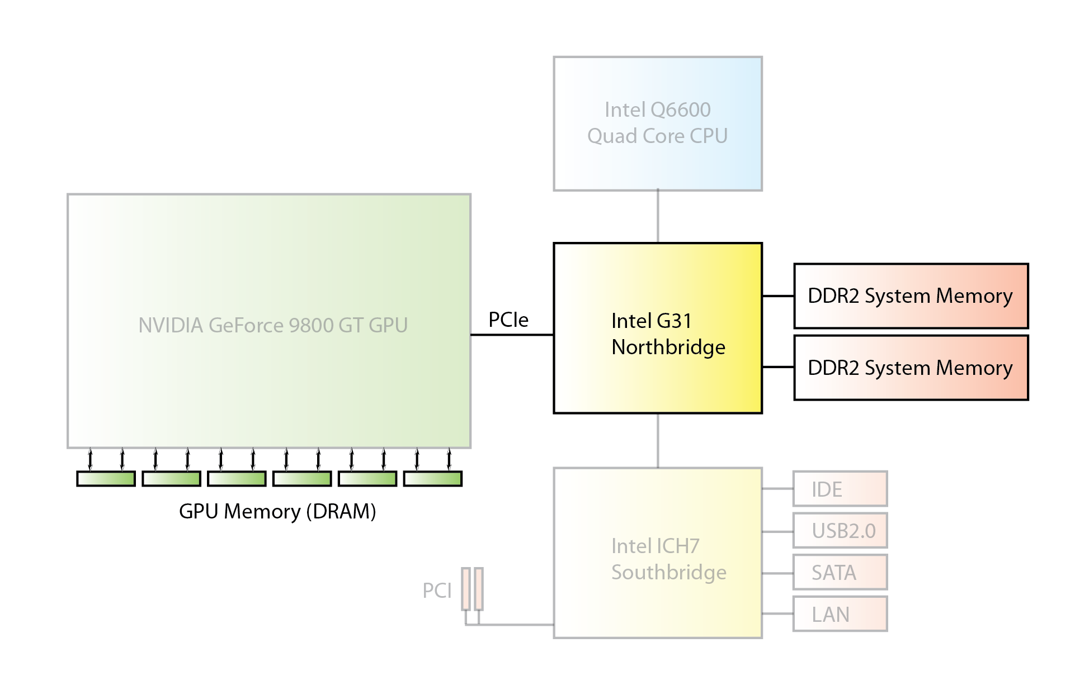
CUDA Runtime API
cudaMemcpy(d, …, …, cudaMemcpyHostToDevice)
0
0
1
1
2
2
…
…
len - 1
len - 1

Slide 6
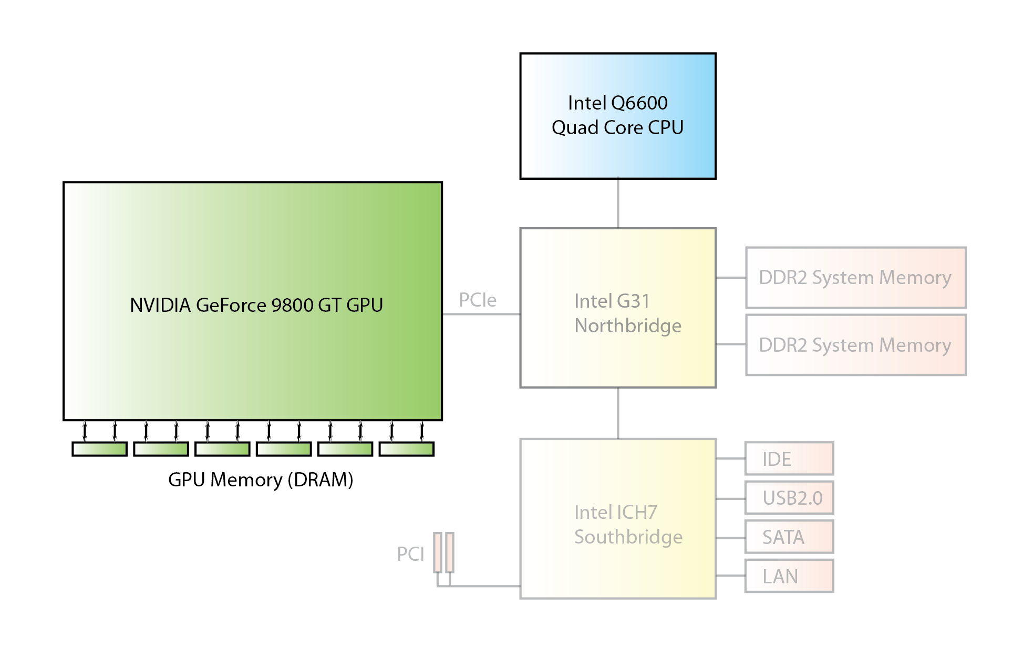
CUDA Runtime API
kernel<<<2, 3>>>(d);
0
0
0
1
1
1
2
2
2
…
…
…
len - 1
len - 1
len - 1
__global__ void kernel(int* d)
{
Int idx= blockIdx.x* blockDim.x+ threadIdx.x;
d[idx] = idx;
}

Slide 7
CUDA Runtime API
cudaMemcpy(…, d, …, cudaMemcpyDeviceToHost)
0
1
2
…
len - 1

Slide 8
CUDA Runtime API
cudaFree(d)
0
1
2
…
len - 1

Slide 9
CUDA Thread Identification
Built-in Variables threadIdx, blockDim, blockIdx, gridDim defined when kernel executes, used to identify what thread is executing.
(Executive Configuration)
…
kernel<<<2, 3>>>(a);
…
__global__ void kernel(int* a)
{
Int idx= blockIdx.x* blockDim.x+ threadIdx.x;
a[idx] = idx;
}
__global__ void kernel(int* a)
{
Int idx= blockIdx.x* blockDim.x+ threadIdx.x;
a[idx] = threadIdx.x;
}
__global__ void kernel(int* a)
{
Int idx= blockIdx.x* blockDim.x+ threadIdx.x;
a[idx] = blockIdx.x;
}
0
1
2
3
4
5
0
1
2
0
1
2
0
0
0
1
1
1

Slide 10
Example: Counting 6’s in CUDA
int main()
{
int size = 300, bsize = 100;
int * h = (int*)malloc(size * sizeof(int));
for (int i = 0; i < size; ++i) h[i] = i % 10;
int * d_in, * d_out;
int blocks = size/bsize;
int threads_per_block = 1;
int rv1 = cudaMalloc(&d_in, size*sizeof(int));
int rv2 = cudaMalloc(&d_out, blocks*sizeof(int));
int rv3 = cudaMemcpy(d_in, h, size*sizeof(int), cudaMemcpyHostToDevice);
c6<<<blocks, threads_per_block>>>(d_in, d_out, bsize);
cudaThreadSynchronize();
int rv4 = cudaGetLastError();
int * r = (int*)malloc(blocks * sizeof(int));
int rv5 = cudaMemcpy(r, d_out, blocks*sizeof(int), cudaMemcpyDeviceToHost);
int sum = 0;
for (int i = 0; i < blocks; ++i)
sum += r[i];
printf("Result = %d\n", sum);
return 0;
}
Host
(CPU)
code
Declare size of array, schunk size
Declare CPU copy of array, initialize
Declare device copies of input and output
Declare blocks per grid, threads per block
Allocate GPU global memory for input/output
Copy host memory to GPU memory
Call GPU, wait for threads to complete,
get errors
Copy from GPU to CPU
Sum up per block count of number of 6’s

Slide 11
Example: Counting 6’s in CUDA
__global__ void c6(int * d_in, int * d_out, int size)
{
int sum = 0;
for (int i=0; i < size; ++i)
{
int val = d_in[i + blockIdx.x * size];
if (val == 6)
sum++;
}
d_out[blockIdx.x] = sum;
}
Declare parameters to kernel
Kernel
(GPU)
code
Initial value of number of 6’s in the chunk
Compute number of 6’s in chunk
Set global memory the sum

Slide 12
Optimizations
To achieve better performance:
Choose good kernel launch configuration
Use constant and shared memories
Avoid bank conflicts in shared memory use
Use coalesced accesses to global memory
Avoid branch divergence in a warp

Slide 13
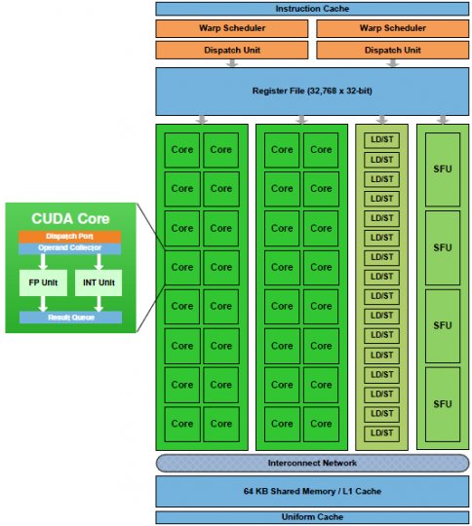
Warps
kernel<<<2, 3>>>(a);
Under the covers, the CUDA Runtime API converts the blocks into warps.
__global__ void kernel(int* a)
{
int idx= blockIdx.x* blockDim.x+ threadIdx.x;
a[idx] = idx;
}
2 blocks, 3 threads per block
2 warps, 32 threads per warp
--29 threads per warp unused

Slide 14
Occupancy
Want to maximize the number of active threads in all multiprocessors at all times.
Occupancy is defined as the ratio of the number of resident warps to the maximum number of resident warps
Function of state of warp residency, registers in use, amount of shared memory in use, and the type of GPU card.

Slide 15
Occupancy
__global__ void kernel(int* a)
{
int idx= blockIdx.x* blockDim.x+ threadIdx.x;
a[idx] = idx;
}
kernel<<<2, 3>>>(a);
2 blocks, 3 threads per block
Maximum number of resident blocks per multiprocessor = 8
Maximum number of resident warps per multiprocessor = 48
Maximum number of resident threads per multiprocessor = 1538
Number of blocks per multiprocessor = 2
Possible Occupancy = 2/48 = 0.042
Max Occupancy = 0.021 because two SM were used
Higher occupancy = better utilization of GPU

Slide 16
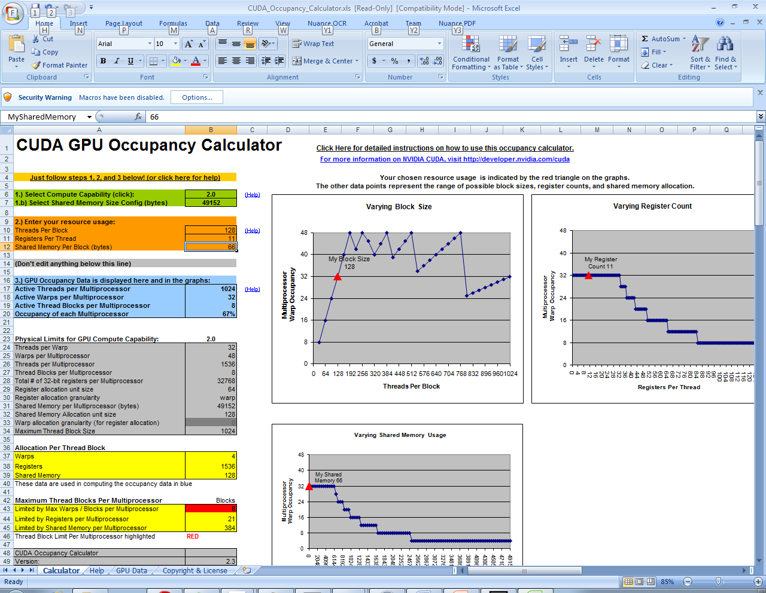
Occupancy
Use the CUDA Occupancy Calculator (an Excel spreadsheet) to compute potential occupancy.

Slide 17
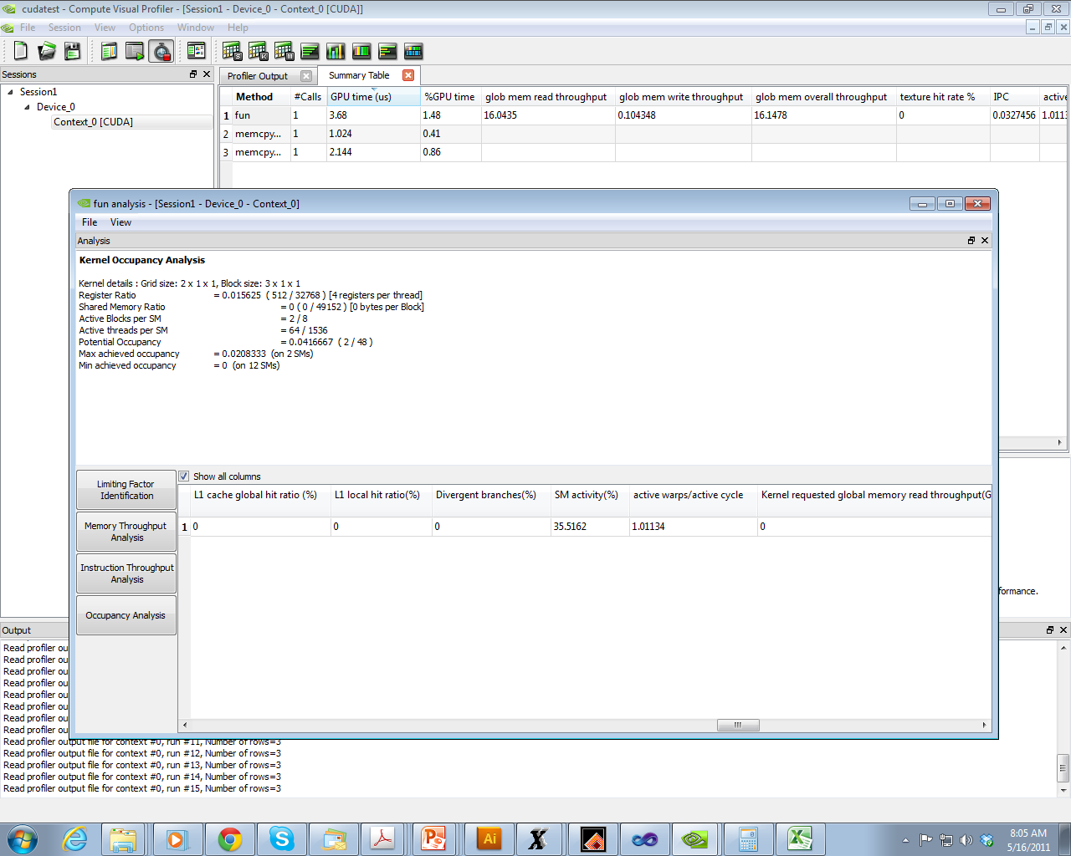
Occupancy
Use the CUDA Compute Visual Profiler to measure real occupancy.

Slide 18
Occupancy
Generally, choose 32 threads per block because that is mapped into one warp, or multiples of 32.

Slide 19
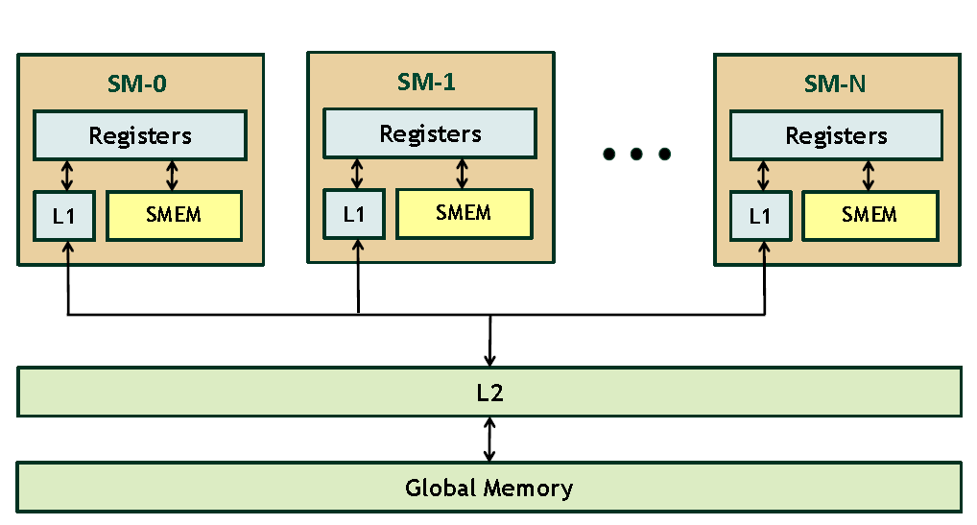
GPU Memory
Streaming Multiprocessors contain
Registers, per thread
Shared memory, per block
L1 cache
L2 cache
Global Memory, per grid
Micikevicius, P. Fundamental Optimizations Supercomputing, New Orleans, Nov 14, 2010, 2010.

Slide 20
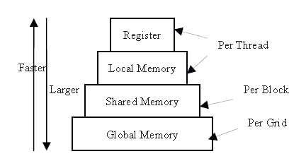
GPU Memory
Memory access times depending on class
Sun, W. and Ma, Z., Count Sort for GPU Computing. in 2009 15th International Conference on Parallel and Distributed Systems, (2009), IEEE Computer Society, 919-924.

Slide 21
Shared memory
Use shared memory to increase the speed of computation because the latency for shared memory is very low.

Slide 22
Counting 6’s using shared memory
Kernel
(GPU)
code
Declare parameters to kernel
__global__ void c6d(int * d_in, int * d_out)
{
__shared__ int sum;
if (threadIdx.x == 0) sum = 0;
__syncthreads();
int val = d_in[threadIdx.x + blockIdx.x * blockDim.x];
if (val == 6)
atomicAdd(&sum, 1);
__syncthreads();
if (threadIdx.x == 0)
d_out[blockIdx.x] = sum;
}
Initial value of number of 6’s in the chunk
Compute number of 6’s in chunk
Synchronize to make sure all threads
computed addition to sum
Set global memory the sum

Slide 23
Shared memory paradigm
Partition data into subsets that fit into shared memory
http://stanford-cs193g-sp2010.googlecode.com/svn/trunk/lectures/lecture_4/cuda_memories.pdf

Slide 24
Shared memory paradigm
Handle each data subset with one thread block
http://stanford-cs193g-sp2010.googlecode.com/svn/trunk/lectures/lecture_4/cuda_memories.pdf

Slide 25
Shared memory paradigm
Load the subset from global memory to shared memory, using multiple threads to exploit memory-level parallelism (prefetching)
http://stanford-cs193g-sp2010.googlecode.com/svn/trunk/lectures/lecture_4/cuda_memories.pdf

Slide 26
Shared memory paradigm
Perform the computation on the subset from shared memory
http://stanford-cs193g-sp2010.googlecode.com/svn/trunk/lectures/lecture_4/cuda_memories.pdf

Slide 27
Shared memory paradigm
Copy the result from shared memory back to global memory
http://stanford-cs193g-sp2010.googlecode.com/svn/trunk/lectures/lecture_4/cuda_memories.pdf

Slide 28
Example – shared variables
// motivate shared variables with
// Adjacent Difference application:
// compute result[i] = input[i] – input[i-1]
__global__ void adj_diff_naive(int *result, int *input)
{
// compute this thread’s global index
unsigned int i = blockDim.x * blockIdx.x + threadIdx.x;
if(i > 0)
{
// each thread loads two elements from global memory
int x_i = input[i];
int x_i_minus_one = input[i-1];
result[i] = x_i – x_i_minus_one;
}
}

Slide 29
Example – shared variables
// motivate shared variables with
// Adjacent Difference application:
// compute result[i] = input[i] – input[i-1]
__global__ void adj_diff_naive(int *result, int *input)
{
// compute this thread’s global index
unsigned int i = blockDim.x * blockIdx.x + threadIdx.x;
if(i > 0)
{
// what are the bandwidth requirements of this kernel?
int x_i = input[i];
int x_i_minus_one = input[i-1];
result[i] = x_i – x_i_minus_one;
}
}
Two loads

Slide 30
Example – shared variables
// motivate shared variables with
// Adjacent Difference application:
// compute result[i] = input[i] – input[i-1]
__global__ void adj_diff_naive(int *result, int *input)
{
// compute this thread’s global index
unsigned int i = blockDim.x * blockIdx.x + threadIdx.x;
if(i > 0)
{
// How many times does this kernel load input[i]?
int x_i = input[i];
int x_i_minus_one = input[i-1];
result[i] = x_i – x_i_minus_one;
}
}
// once by thread i
// again by thread i+1

Slide 31
Example – shared variables
// motivate shared variables with
// Adjacent Difference application:
// compute result[i] = input[i] – input[i-1]
__global__ void adj_diff_naive(int *result, int *input)
{
// compute this thread’s global index
unsigned int i = blockDim.x * blockIdx.x + threadIdx.x;
if(i > 0)
{
// Idea: eliminate redundancy by sharing data
int x_i = input[i];
int x_i_minus_one = input[i-1];
result[i] = x_i – x_i_minus_one;
}
}

Slide 32
Example – shared variables
// optimized version of adjacent difference
__global__ void adj_diff(int *result, int *input)
{
// shorthand for threadIdx.x
int tx = threadIdx.x;
// allocate a __shared__ array, one element per thread
__shared__ int s_data[BLOCK_SIZE];
// each thread reads one element to s_data
unsigned int i = blockDim.x * blockIdx.x + tx;
s_data[tx] = input[i];
// avoid race condition: ensure all loads
// complete before continuing
__syncthreads();
if(tx > 0)
result[i] = s_data[tx] – s_data[tx–1];
else if(i > 0)
{
// handle thread block boundary
result[i] = s_data[tx] – input[i-1];
}
}
Notes:
The __syncthreads call avoids a race condition to s_data
There’s still one unavoidable redundant load per block – the first thread of block i needs data in the __shared__ array of block i-1, but there’s no way to get to it

Slide 33
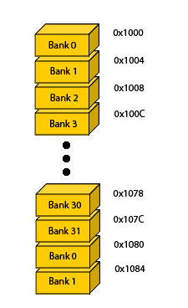
Problem with Shared Memory: Bank conflict
Shared memory is organized into 32 banks.
Addresses in shared memory are interleaved banks, 4 bytes quantities, accessible in 2 cycles per warp.

Slide 34
Problem with Shared Memory: Bank conflict
Any memory read or write request made of n addresses that fall in n distinct memory banks can therefore be serviced simultaneously, yielding an overall bandwidth that is n times as high as the bandwidth of a single module.
If two addresses of a memory request fall in the same memory bank, there is a bank conflict and the access has to be serialized.
NVIDIA NVIDIA CUDA™ Programming Guide Version 3.0, 2010.

Slide 35
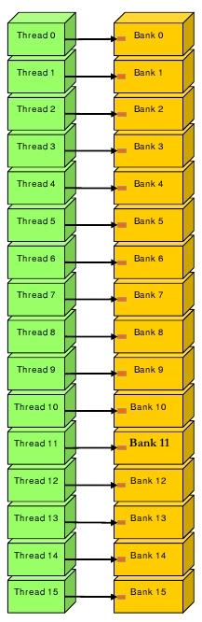
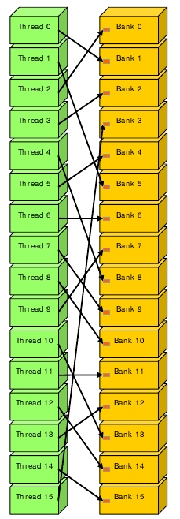
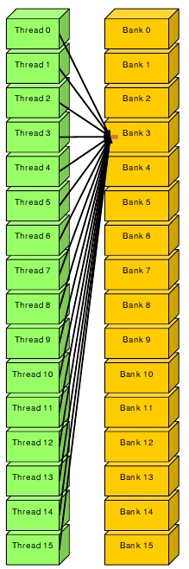
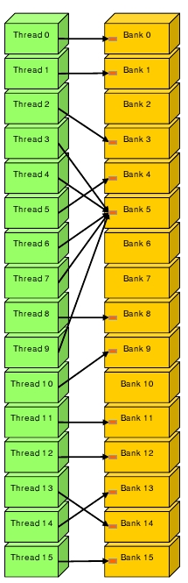
Shared Memory: without Bank Conflict
one access per bank
one access per bank with shuffling
access the same address (broadcast)
partial broadcast and skipping some banks
NVIDIA NVIDIA CUDA™ Programming Guide Version 3.0, 2010.

Slide 36
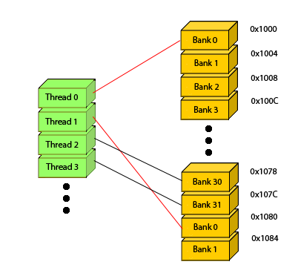
Shared Memory: with Bank Conflict
access more than one address per bank

Slide 37
Bank conflict
#define NUM_BANKS 32
#define NUM_THREADS 32
__shared__ int mem [NUM_BANKS * NUM_THREADS];
__global__ void bad_access(int *out, int iters) {
int idx = threadIdx.x;
int min = idx * NUM_BANKS;
int max = (idx + 1) * NUM_BANKS;
int inc = 1;
for (int j = min; j < max; j += inc)
mem[j] = 0;
for (int i = 0; i < iters; i++)
for (int j = min; j < max; j += inc)
mem[j]++;
for (int j = min; j < max; j += inc)
out[j] = mem[j];
}
Bank conflict here
Notes:
In the 1st for-loop, each thread writes to the same bank for mem[j].
In the 2nd for-loop, the inner for-loop reads then writes to the same bank (mem[j]).
In the 3rd for-loop, each thread reads from the same bank for mem[j].

Slide 38
Bank conflict
for (int j = min; j < max; j += inc) mem[j] = 0;
MEM[i] | Bank 1 | Bank 2 | Bank 3 | … | Bank 30 | Bank 31 | Bank 32
Thread 1 | 0 | 1 | 2 |  | 29 | 30 | 31
Thread 2 | 32 | 33 | 34 |  | 61 | 62 | 63
Thread 3 | 64 | 65 | 66 |  | 93 | 94 | 95
…
Thread 30 | 928 | 929 | 930 |  | 957 | 958 | 959
Thread 31 | 960 | 961 | 962 |  | 989 | 990 | 991
Thread 32 | 992 | 993 | 994 |  | 1021 | 1022 | 1023
j = 0, 32, 64, …, 928, 960, 992 for threads 1, 2, 3, … 32

Slide 39
Bank conflict
for (int j = min; j < max; j += inc) mem[j] = 0;
MEM[i] | Bank 1 | Bank 2 | Bank 3 | … | Bank 30 | Bank 31 | Bank 32
Thread 1 | 0 | 1 | 2 |  | 29 | 30 | 31
Thread 2 | 32 | 33 | 34 |  | 61 | 62 | 63
Thread 3 | 64 | 65 | 66 |  | 93 | 94 | 95
…
Thread 30 | 928 | 929 | 930 |  | 957 | 958 | 959
Thread 31 | 960 | 961 | 962 |  | 989 | 990 | 991
Thread 32 | 992 | 993 | 994 |  | 1021 | 1022 | 1023
j = 1, 33, 65, …, 929, 961, 993 for threads 1, 2, 3, … 32

Slide 40
Bank conflict
for (int j = min; j < max; j += inc) mem[j] = 0;
MEM[i] | Bank 1 | Bank 2 | Bank 3 | … | Bank 30 | Bank 31 | Bank 32
Thread 1 | 0 | 1 | 2 |  | 29 | 30 | 31
Thread 2 | 32 | 33 | 34 |  | 61 | 62 | 63
Thread 3 | 64 | 65 | 66 |  | 93 | 94 | 95
…
Thread 30 | 928 | 929 | 930 |  | 957 | 958 | 959
Thread 31 | 960 | 961 | 962 |  | 989 | 990 | 991
Thread 32 | 992 | 993 | 994 |  | 1021 | 1022 | 1023
j = 2, 34, 66, …, 930, 962, 994 for threads 1, 2, 3, … 32

Slide 41
Bank conflict fixed
#define NUM_BANKS 32
#define NUM_THREADS 32
__shared__ int mem [NUM_BANKS * NUM_THREADS];
__global__ void good_access(int *out, int iters) {
int idx = threadIdx.x;
int min = idx;
int max = blockDim.x * NUM_BANKS;
int inc = NUM_BANKS;
for (int j = min; j < max; j += inc)
mem[j] = 0;
for (int i = 0; i < iters; i++)
for (int j = min; j < max; j += inc)
mem[j]++;
for (int j = min; j < max; j += inc)
out[j] = mem[j];
}
Bank conflict fixed

Slide 42
Bank conflict fixed
for (int j = min; j < max; j += inc) mem[j] = 0;
MEM[i] | Bank 1 | Bank 2 | Bank 3 | … | Bank 30 | Bank 31 | Bank 32
Thread 1 | 0 | 1 | 2 |  | 29 | 30 | 31
Thread 2 | 32 | 33 | 34 |  | 61 | 62 | 63
Thread 3 | 64 | 65 | 66 |  | 93 | 94 | 95
…
Thread 30 | 928 | 929 | 930 |  | 957 | 958 | 959
Thread 31 | 960 | 961 | 962 |  | 989 | 990 | 991
Thread 32 | 992 | 993 | 994 |  | 1021 | 1022 | 1023
j = 0, 1, 2, …, 29, 30, 31 for threads 1, 2, 3, … 32

Slide 43
Bank conflict fixed
for (int j = min; j < max; j += inc) mem[j] = 0;
MEM[i] | Bank 1 | Bank 2 | Bank 3 | … | Bank 30 | Bank 31 | Bank 32
Thread 1 | 0 | 1 | 2 |  | 29 | 30 | 31
Thread 2 | 32 | 33 | 34 |  | 61 | 62 | 63
Thread 3 | 64 | 65 | 66 |  | 93 | 94 | 95
…
Thread 30 | 928 | 929 | 930 |  | 957 | 958 | 959
Thread 31 | 960 | 961 | 962 |  | 989 | 990 | 991
Thread 32 | 992 | 993 | 994 |  | 1021 | 1022 | 1023
j = 32, 33, 34, …, 61, 62, 63 for threads 1, 2, 3, … 32

Slide 44
Bank conflict fixed
for (int j = min; j < max; j += inc) mem[j] = 0;
MEM[i] | Bank 1 | Bank 2 | Bank 3 | … | Bank 30 | Bank 31 | Bank 32
Thread 1 | 0 | 1 | 2 |  | 29 | 30 | 31
Thread 2 | 32 | 33 | 34 |  | 61 | 62 | 63
Thread 3 | 64 | 65 | 66 |  | 93 | 94 | 95
…
Thread 30 | 928 | 929 | 930 |  | 957 | 958 | 959
Thread 31 | 960 | 961 | 962 |  | 989 | 990 | 991
Thread 32 | 992 | 993 | 994 |  | 1021 | 1022 | 1023
j = 64, 65, 66, …, 93, 94, 95 for threads 1, 2, 3, … 32

Slide 45
Coalesced access
Fast access to global memory for older GeForce GPU’s (1.0 to 1.3 compute capability).
For newer GeForce GPU’s (2.0), coalesced access does not exist.
A half warp can access one 32- (or 64-, 128-) byte memory quantity in one transaction, if three conditions met.

Slide 46
Coalesced access
To coalesce, the global memory request for a half-warp must satisfy the following conditions:
1) The size of the words accessed by the threads must be 4, 8, or 16 bytes;
2) 4, all 16 words must lie in the same 64-byte segment; 8, 16 …
3) Threads must access the words in sequence: The kth thread in the half-warp must access the kth word.

Slide 47
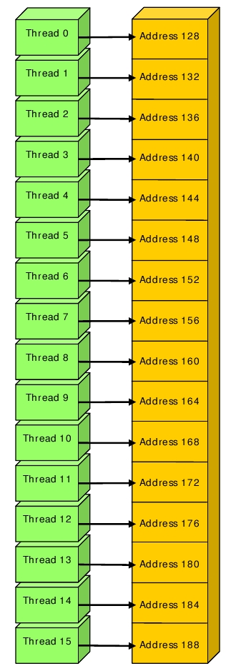
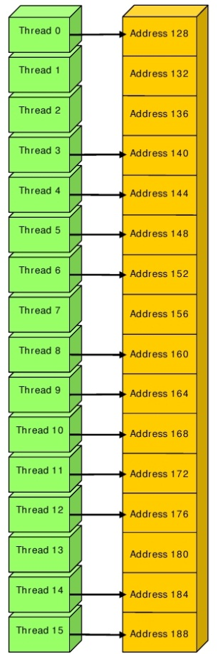
Global Memory: Coalesced Access
perfectly coalesced
allow threads skipping LD/ST
NVIDIA NVIDIA CUDA™ Programming Guide Version 3.0, 2010.

Slide 48
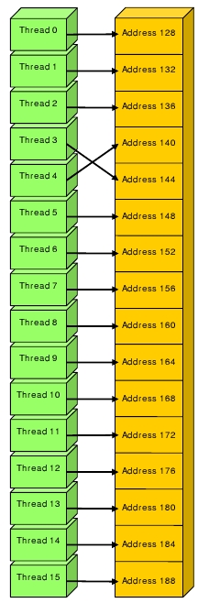
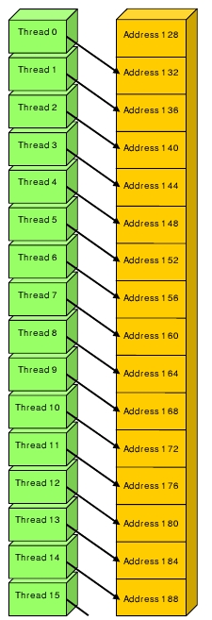
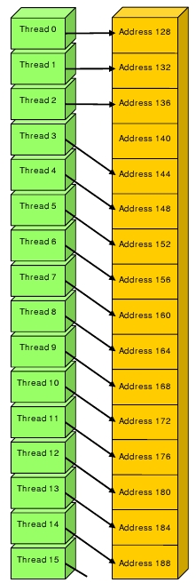
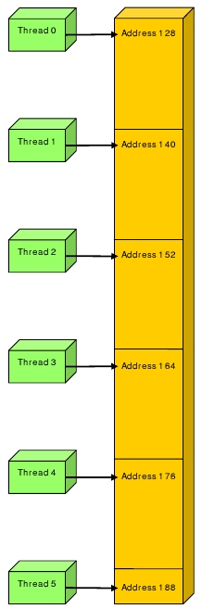
Global Memory: Non-Coalesced Access
non-consecutive
address
starting address not aligned to 128 Byte
non-consecutive
address
stride larger than one word
NVIDIA NVIDIA CUDA™ Programming Guide Version 3.0, 2010.

Slide 49
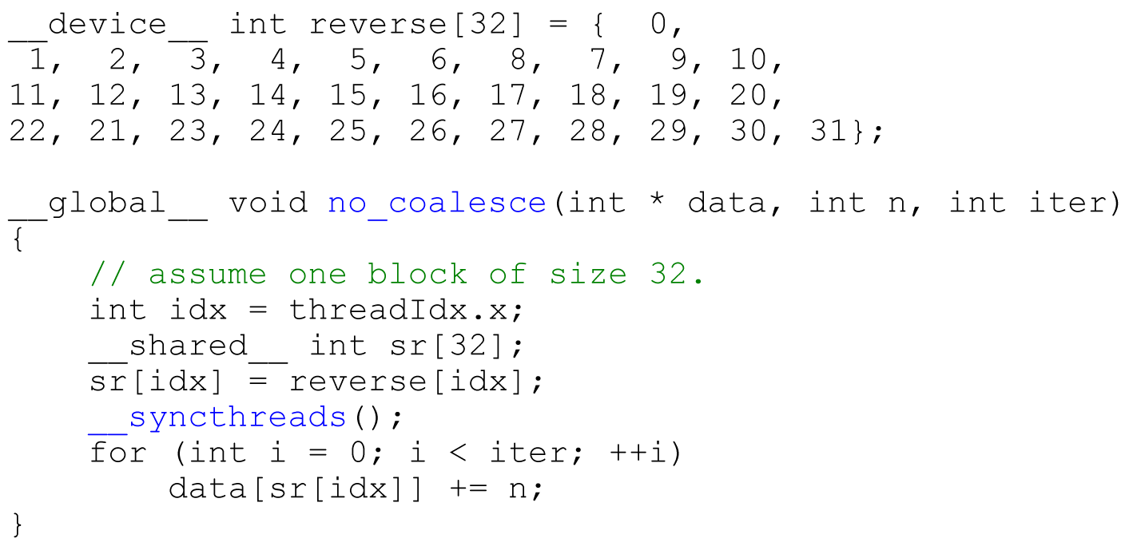
Coalesced access

Slide 50
Coalesced access
Threads 0-15 access data[] in 4 byte quantities consecutively, from 0 to 63. Therefore, this half warp is coalesced.
Threads 16-31 access data[] in 4 byte quantities consecutively, from 64 to 127. Therefore, this half warp is coalesced.
Thread id | &data[]
0 | 0
1 | 4
3 | 8
…
16 | 64
17 | 68
18 | 72
…

Slide 51
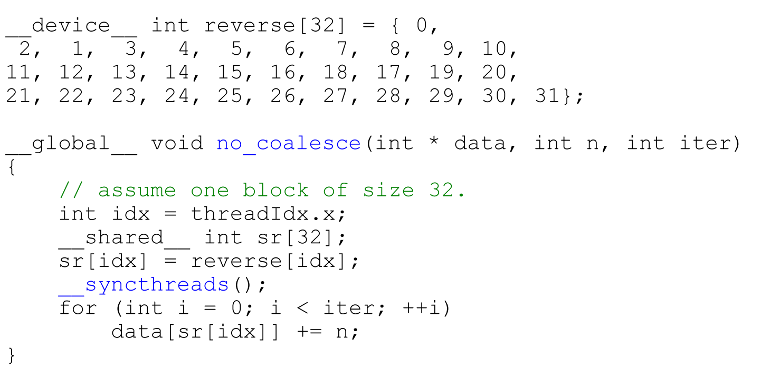
Coalesced access

Slide 52
Coalesced access
Threads 1 and 2 do not access data[] consecutively. Therefore, this half warp is NOT coalesced.
Threads 17 and 18 do not access data[] consecutively. Therefore, this half warp is NOT coalesced.
Thread id | &data[]
0 | 0
1 | 8
3 | 4
…
16 | 64
17 | 72
18 | 68
…

Slide 53
Basic algorithms
The REDUCE and SCAN primitives

Slide 54
Time warp… What do these APL statements do?
+/22 93 4.6 10 3.3
132.9
×/11 3 2 10
660
⋁/1 1 0 1
1
+\22 93 4.6 10 3.3
22 115 119.6 129.6 132.9
×\1 2 3 5
1 2 6 30
=\0 0 0 0 0 0 0 0 0
0 1 0 1 0 1 0 1 0
op/ is a SCAN; op\ is a REDUCE

Slide 55
What is REDUCE?
Definition: The REDUCE operation takes a binary operator ⊕ with identity I, and an ordered set [a₀, a₁, ..., a_{n−1}] of n elements, and returns the value (((a₀ ⊕ a₁) ⊕ ... ) ⊕ a_{n−1}).
For our discussions, consider only associative, commutative operators. We want to perform operations in any order.
Blelloch, G. Prefix Sums and Their Applications, 1990

Slide 56
What is SCAN?
Definition: The SCAN operation takes a binary operator ⊕, and an ordered set of n elements [a₀, a₁, ..., a_{n−1}], and returns the ordered set [a₀, (a₀ ⊕ a₁), ..., (a₀ ⊕ a₁ ⊕ ... ⊕ a_{n−1})].
AKA “inclusive prefix”, “all-prefix-sums” (addition)
Let’s only consider associative binary operators…
http://www.microapl.co.uk/apl/LearningAPLwithAPLX.pdf

Slide 57
Why is REDUCE and SCAN important?
If ⊕ is addition, then REDUCE computes the summation.
If ⊕ is dyadic min function (i.e., min(x,y) = x > y ? y : x), then REDUCE finds the minimum of all numbers.
SCAN is used in many sorting algorithms.
Blelloch, G. Prefix Sums and Their Applications, 1990

Slide 58
Sequential implementation of REDUCE
Result = I
for i:= 1 to n do
Result = Result ⊕ x[i]

Slide 59
Naïve parallel implementation of REDUCE
for (d = 0; d ≤ log₂n – 1; ++d)
do
for P_{i}, 0 ≤ i ≤ log₂n - d in parallel
do
a[(i +1) * 2^{d+1} - 1] = a[i * 2^{d+1} + 2^{d} - 1] + a[(i +1) * 2^{d+1} - 1]
end
end
Blelloch, G. Prefix Sums and Their Applications, 1990

Slide 60
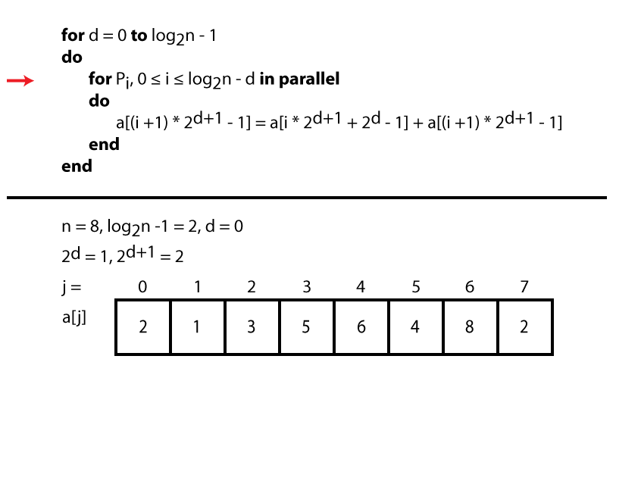
Naïve parallel implementation of REDUCE
= 31?

Slide 61
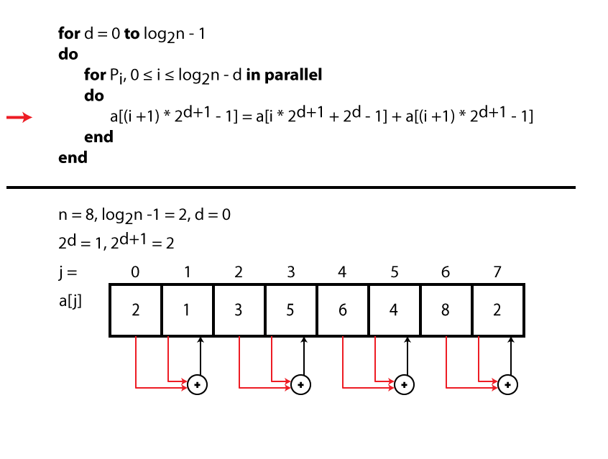
Naïve parallel implementation of REDUCE
= 31?

Slide 62
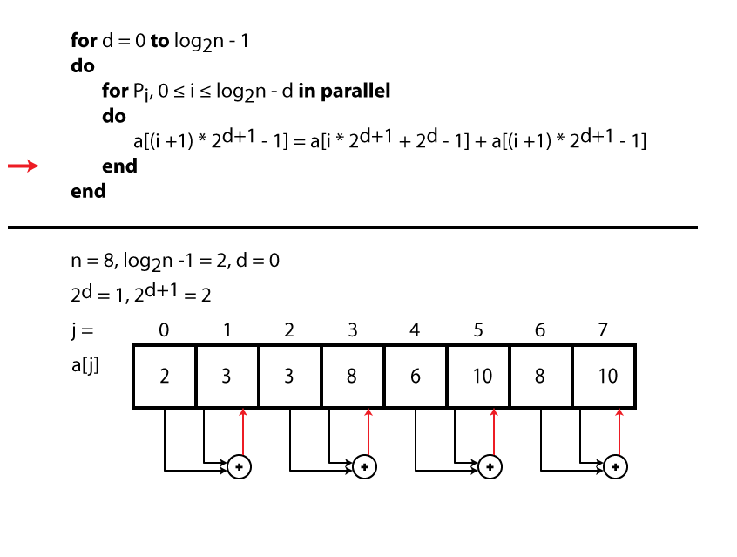
Naïve parallel implementation of REDUCE
= 31?

Slide 63

Naïve parallel implementation of REDUCE
= 31?

Slide 64
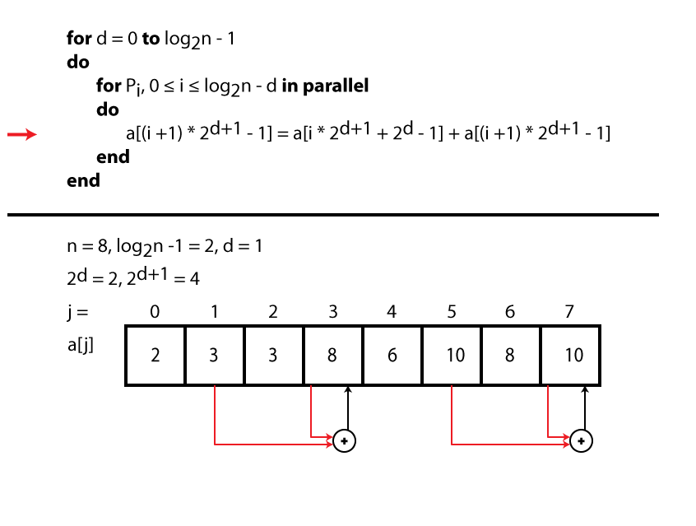
Naïve parallel implementation of REDUCE
= 31?

Slide 65
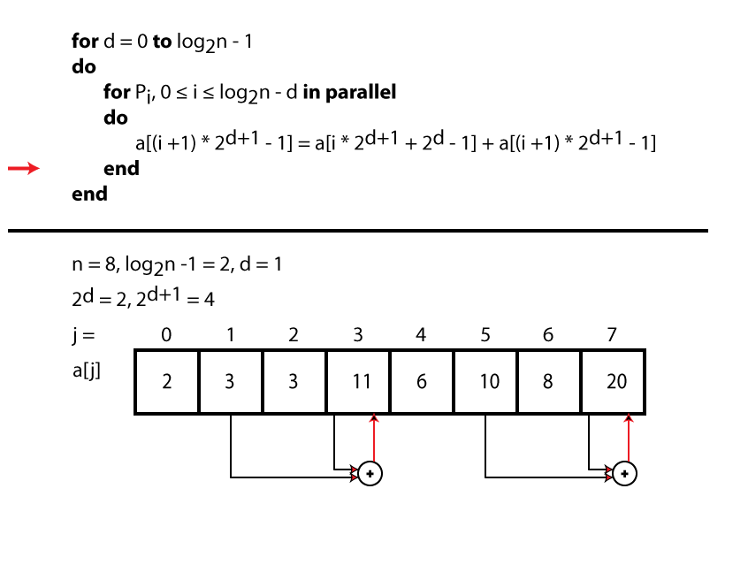
Naïve parallel implementation of REDUCE
= 31?

Slide 66

Naïve parallel implementation of REDUCE
= 31?

Slide 67
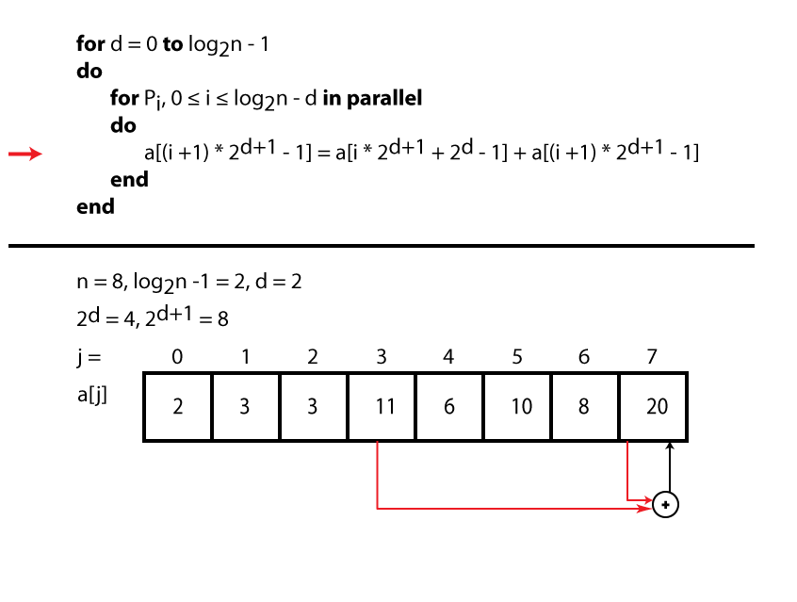
Naïve parallel implementation of REDUCE
= 31?

Slide 68
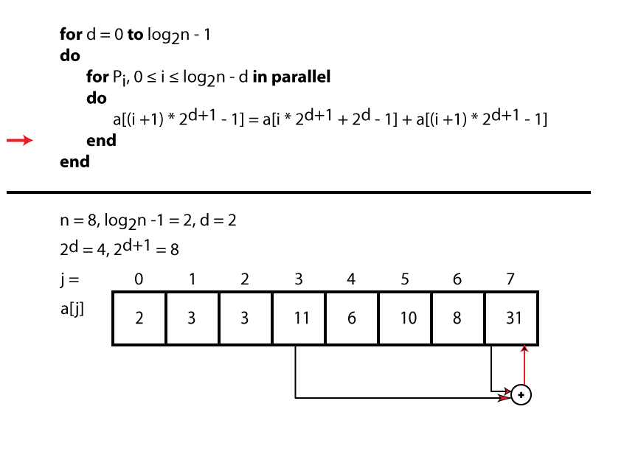
Naïve parallel implementation of REDUCE
= 31☑

Slide 69
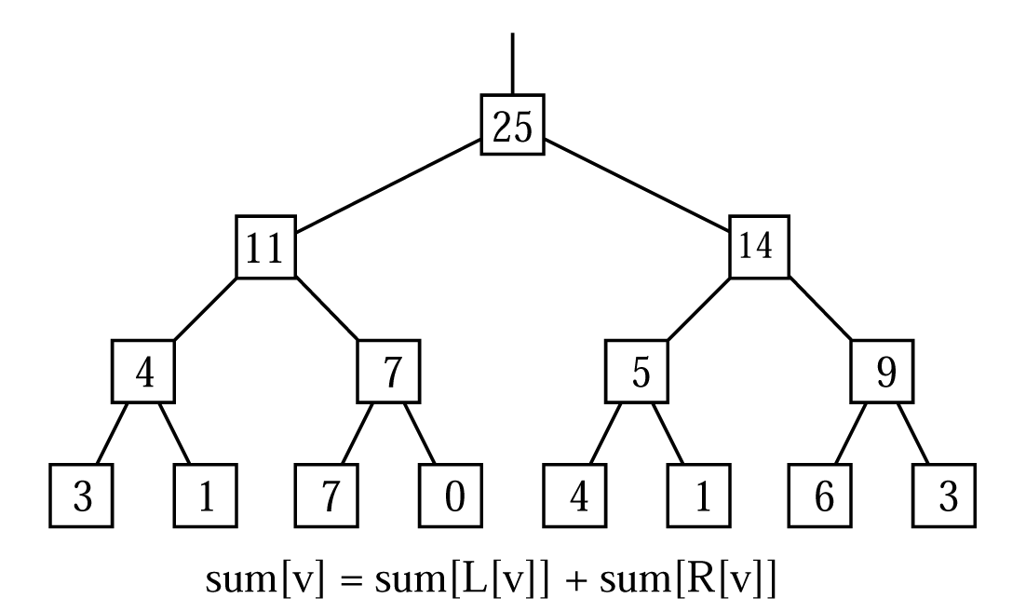
REDUCE using a tree
Blelloch, G. Prefix Sums and Their Applications, 1990

Slide 70
CUDA implementation of REDUCE
Naïve implementation:
Problem with this implementation:
Modifies input
Slow!
__global__ void reduce0(int *g_idata, int *g_odata)
{
unsigned int tid = threadIdx.x;
unsigned int i = blockIdx.x * blockDim.x + threadIdx.x;
for (unsigned int s=1; s < blockDim.x; s *= 2)
{
if (tid % (2*s) == 0)
g_idata[tid] += g_idata[i + s];
__syncthreads();
}
}

Slide 71
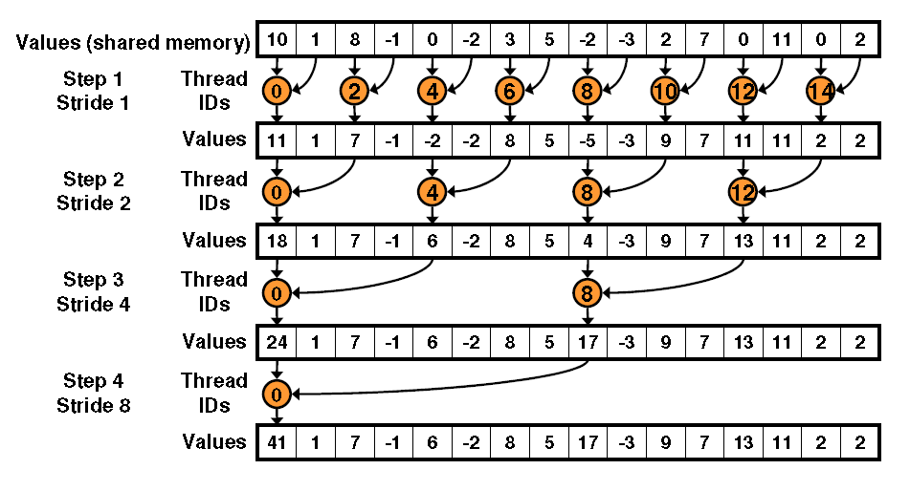
CUDA implementation of REDUCE

Slide 72
CUDA implementation of REDUCE
Better implementation:
Uses parallelism in global data loading into shared memory
Does not modify input data
Problem with this implementation:
Has bank conflicts
__global__ void reduce1(int *g_idata, int *g_odata)
{
extern __shared__ int sdata[];
// each thread loads one element into shared mem
unsigned int tid = threadIdx.x;
unsigned int i = blockIdx.x * blockDim.x + threadIdx.x;
sdata[tid] = g_idata[i];
__syncthreads();
// do reduction in shared mem
for (unsigned int s=1; s < blockDim.x; s *= 2)
{
if (tid % (2*s) == 0)
sdata[tid] += sdata[tid + s];
__syncthreads();
}
// write result for this block to global mem
if (tid == 0) g_odata[blockIdx.x] = sdata[0];
}

Slide 73
CUDA implementation of REDUCE

Slide 74
CUDA implementation of REDUCE
Even better implementation:
Solves highly divergent code
__global__ void reduce2(int *g_idata, int *g_odata)
{
extern __shared__ int sdata[];
// each thread loads one element into shared mem
unsigned int tid = threadIdx.x;
unsigned int i= blockIdx.x * blockDim.x + threadIdx.x;
sdata[tid] = g_idata[i];
__syncthreads();
// do reduction in shared mem
for (unsigned int s = blockDim.x / 2; s>0; s>>=1)
{
if (tid < s)
sdata[tid] += sdata[tid + s];
__syncthreads();
}
// write result for this block to global mem
if (tid == 0) g_odata[blockIdx.x] = sdata[0];
}

Slide 75
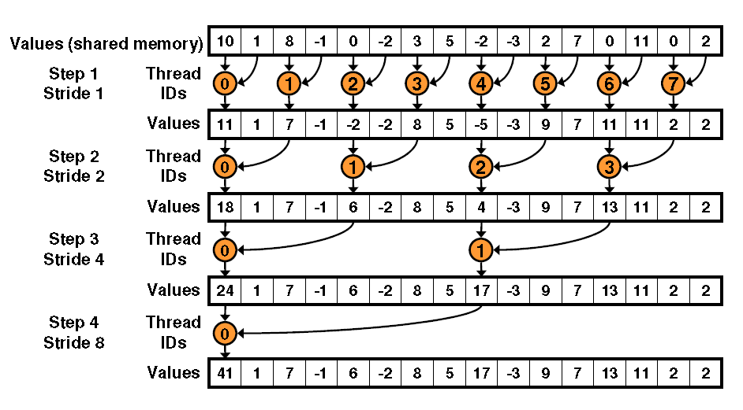
CUDA implementation of REDUCE
(This is better, but there are still problems: bank conflict!)

Slide 76
What is SCAN?
Definition: The SCAN operation takes a binary associative, commutative operator ⊕, and an ordered set of n elements [a₀, a₁, ..., a_{n−1}], and returns the ordered set [a₀, (a₀ ⊕ a₁), ..., (a₀ ⊕ a₁ ⊕ ... ⊕ a_{n−1})].
Definition: The PRESCAN operation takes a binary associative, commutative operator ⊕, identity I over ⊕, and an ordered set of n elements [a₀, a₁, ..., a_{n−1}], and returns the ordered set [I, a₀, (a₀ ⊕ a₁), ..., (a₀ ⊕ a₁ ⊕ ... ⊕ a_{n−1})].
AKA “exclusive scan” and “exclusive prefix”.
Blelloch, G. Prefix Sums and Their Applications, 1990

Slide 77
Sequential implementation of SCAN
for i:= 1 to n do
x[i] = x[i-1] ⊕ x[i]

Slide 78
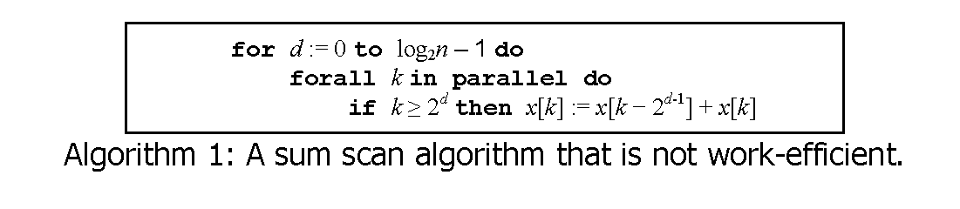
Naïve parallel implementation of SCAN
Harris, M. Parallel prefix sum (scan) with CUDA, NVIDIA, 2009.
Notes:
(⊕ = +)

Slide 79
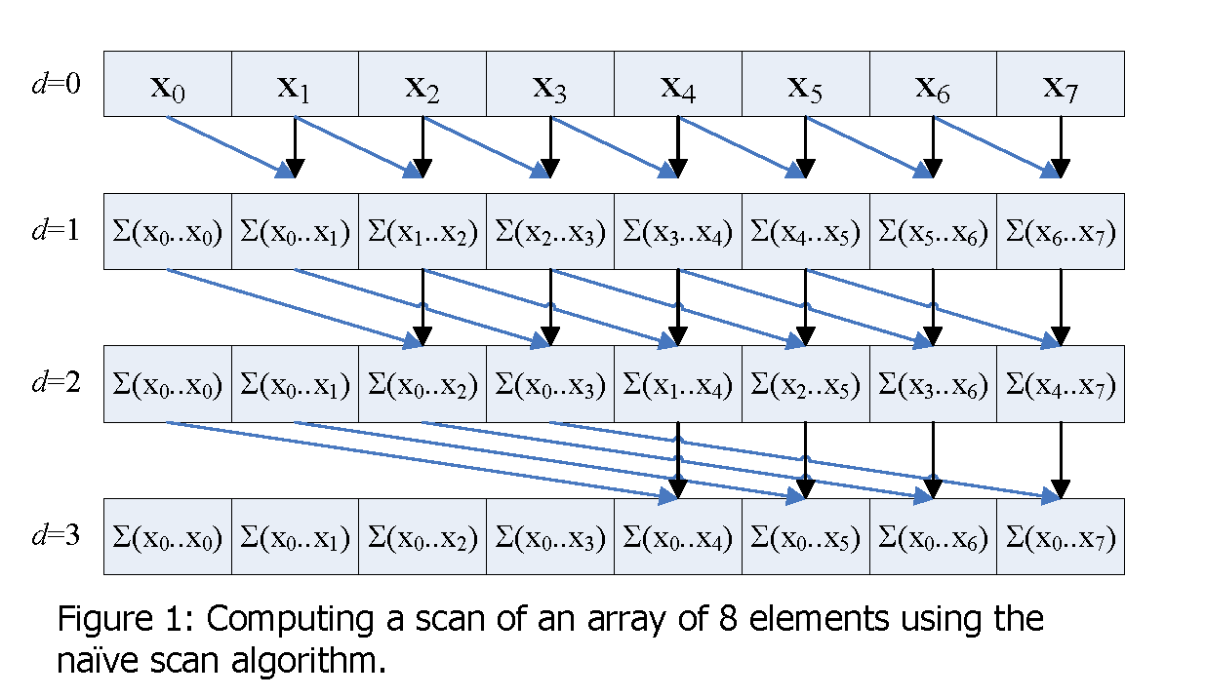
Naïve parallel implementation of SCAN
Harris, M. Parallel prefix sum (scan) with CUDA, NVIDIA, 2009.

Slide 80
Naïve parallel implementation of SCAN
Problem: “Algorithm 1” assumes all fetches and additions occur simultaneously in x[k – 2^{d-1}] + x[k] for a given d.
In a Tesla GPU, this is not the case. Threads execute in a Warp, which has 32 threads, and Warps execute sequentially.
Need to separate input from output: double buffering.

Slide 81
Naïve parallel implementation of SCAN
swap(xout, xin)
for d:= 1 to log₂n do
swap(xout, xin)
forall k in parallel do
if k >= d then
xout[k] = xin[k – 2^{d-1}] + xin[k]
else
xout[k] = xin[k]
Notes:
This algorithm is similar to Algorithm 1, except it uses double buffering to avoid problems associated with Warp serialization.
Xin contains the input data, and xout the output data. Warps in the forall…parallel can be serialized but still
Let’s go back to the Move SWAP to beginning. This allows for xout to always be result.
Also, simplify the array so it is one-dimensional, instead of two-dimensional.
SEGWAY: Following this algorithm, we do get an implementation in CUDA that works.

Slide 82
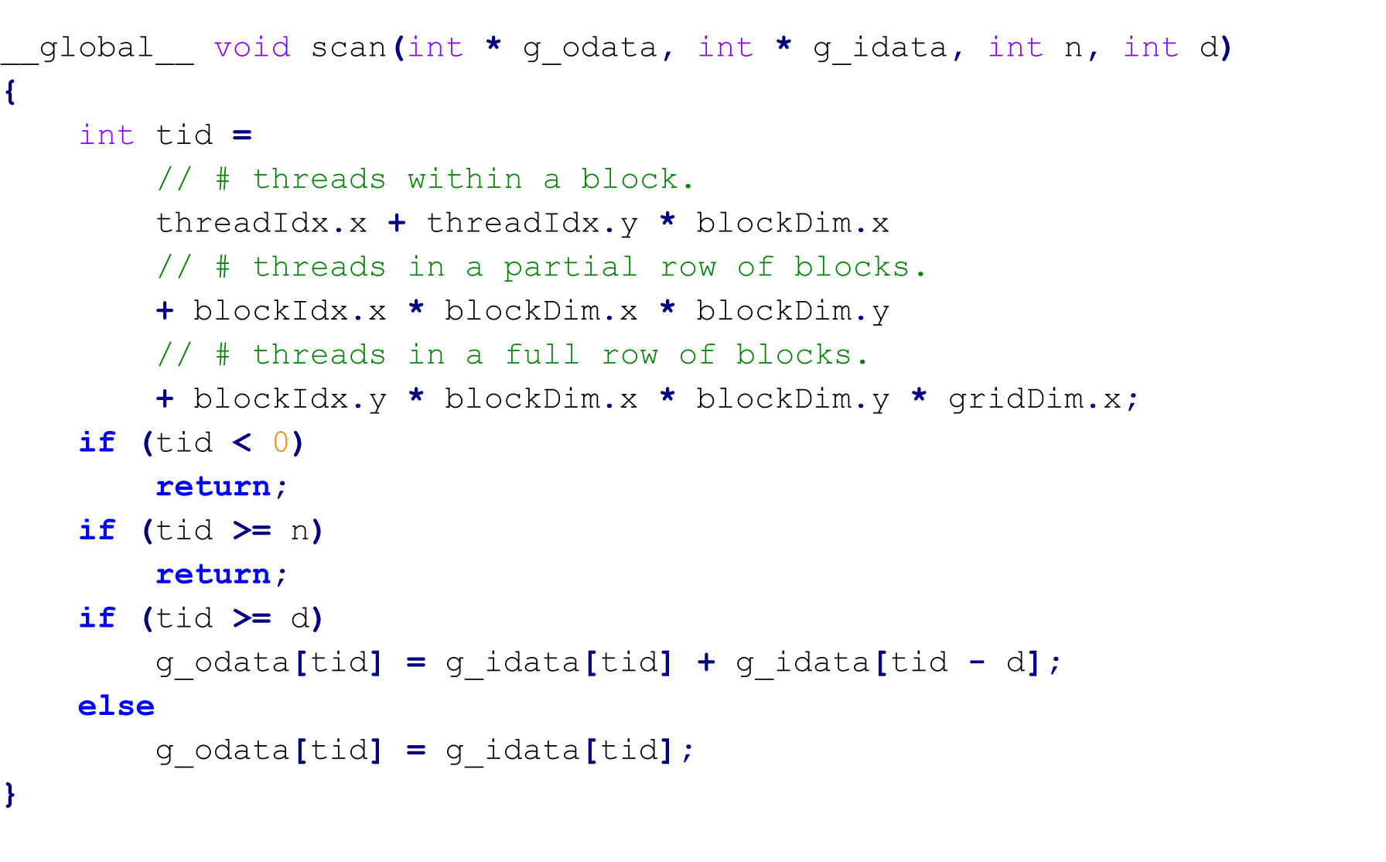
Naïve parallel implementation of SCAN
WORKS BUT IS INEFFICIENT + SLOWER THAN SERIAL IMPLEMENTATION!

Slide 83
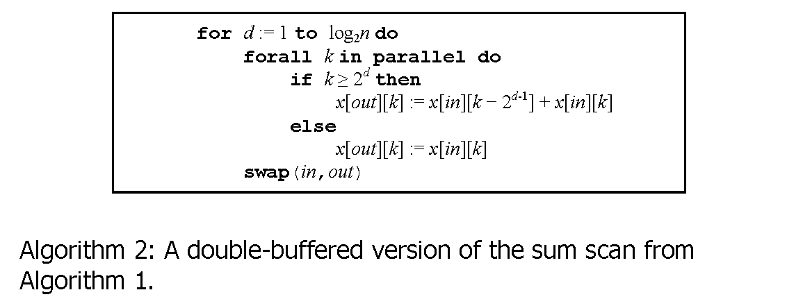
Naïve parallel implementation of SCAN
Harris, M. Parallel prefix sum (scan) with CUDA, NVIDIA, 2009.
Notes:
This algorithm is similar to Algorithm 1, except it uses double buffering to avoid any serialized threads.
SEGWAY: How would this be implemented in CUDA?

Slide 84
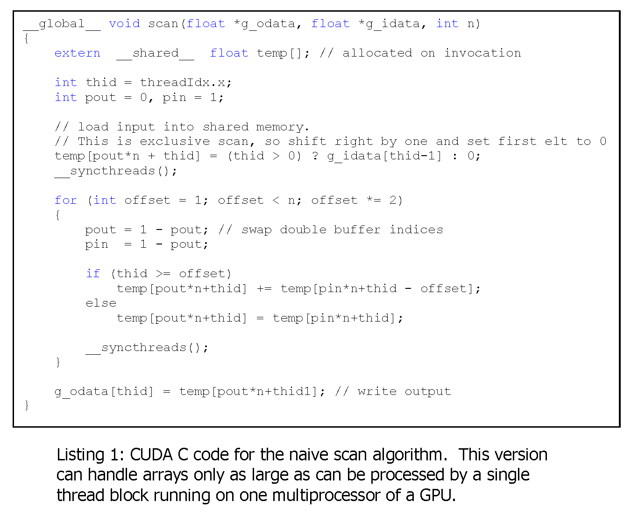

Naïve parallel implementation of SCAN
Watch out for “free” software and algorithms!
Harris, M. Parallel prefix sum (scan) with CUDA, NVIDIA, 2009.
Notes:
This is an implementation given by Harris which supposedly implemented Algorithm 2. But, there are a lot of problems with this implementation.
It does not compile;
It does not compute the right value (references uninitialized data);
Computes prescan, not scan;
Does not follow the Algorithm2 psuedocode: the for-loop for “d” is placed within the kernel, not outside.
Beware of code listings…they may not work!
SEGWAY: How would we implement a version that works?

Slide 85
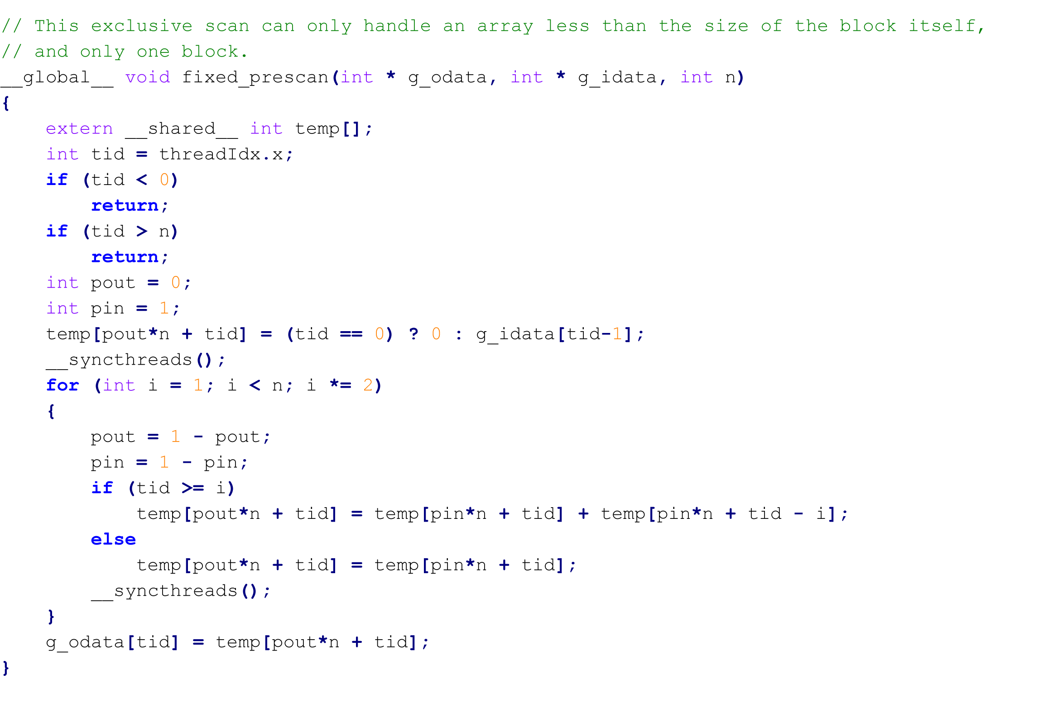
Naïve parallel implementation of SCAN
WORKS BUT DOES NOT SCALE
Notes:
Not scalable (limits in the implementation on what problems can be solved);

Slide 86
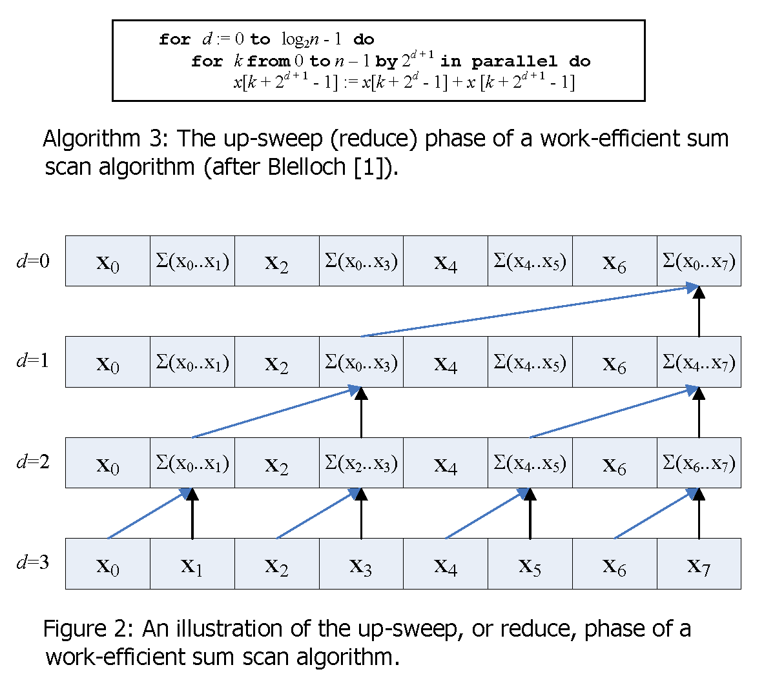
Blelloch SCAN

Slide 87
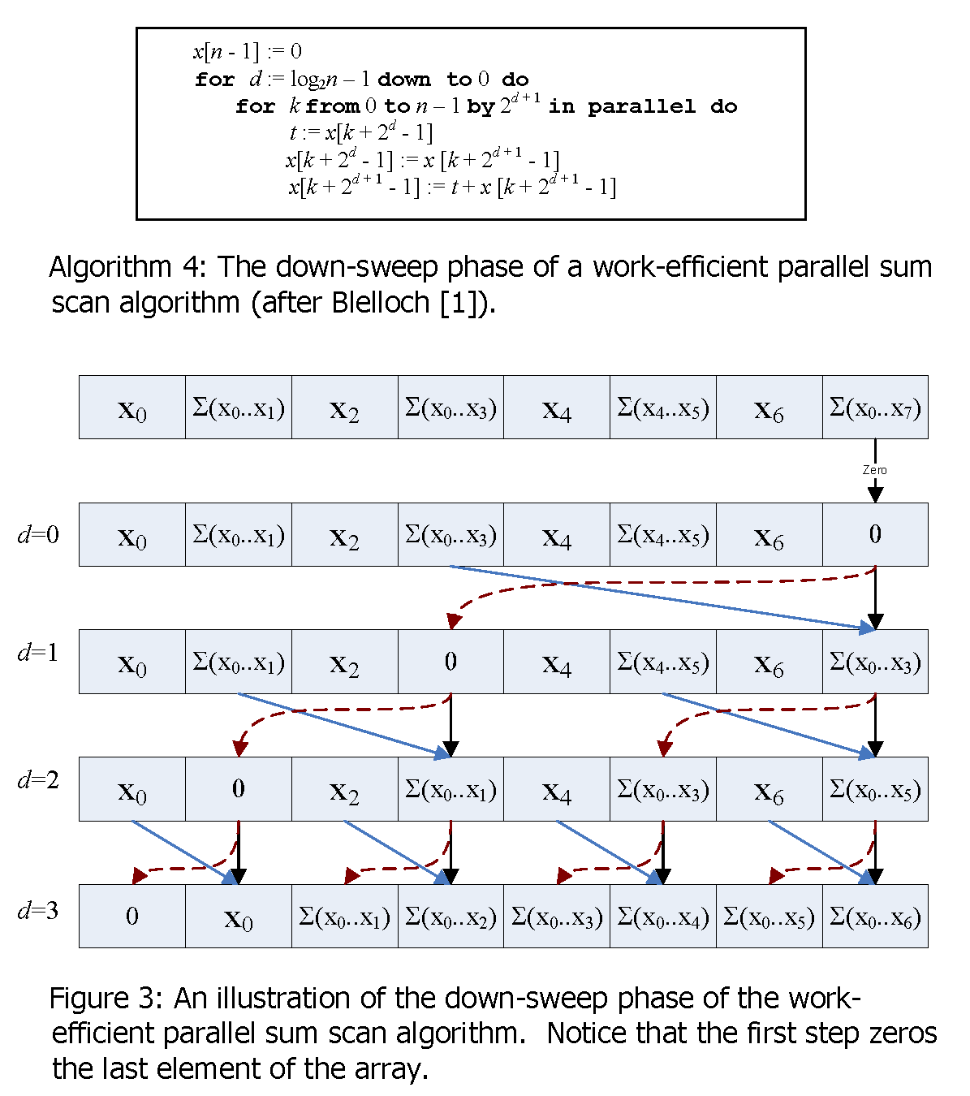
Blelloch SCAN

Slide 88
Scalable Parallel implementation of SCAN
Step 1: Run naïve or Blelloch parallel PRESCAN on blocks. This computes the PRESCAN for each block without regard to other blocks.
Step 2: Run naïve or Blelloch parallel SCAN on top values in all blocks. Consider an array F in which the values are the last value in each block in step 1. Compute SCAN for array F.
Step 3: Update all values in all blocks with the values in array F.
Implementation… see code at http://domemtech.com/ieee_pp/scan.zip.

Slide 89
Basic algorithms
Sorting

Slide 90
Counting Sort
c
-
-
-
-
-
-
COUNTING_SORT (A, B, k)
for i ← 1 to k do
c[i] ← 0
for j ← 1 to n do
c[A[j]] ← c[A[j]] + 1
//c[i] now contains the number of elements equal to i
for i ← 2 to k do
c[i] ← c[i] + c[i-1]
// c[i] now contains the number of elements ≤ i
for j ← n downto 1 do
B[c[A[i]]] ← A[j]
c[A[i]] ← c[A[j]] - 1
Cormen, T., Leiserson, C., Rivest, R. and Stein, C. Introduction to Algorithms. MIT Press McGraw-Hill Book Company, 2001.
For animation, see http://users.cs.cf.ac.uk/C.L.Mumford/tristan/CountingSort.html

Slide 91
Counting Sort
COUNTING_SORT (A, B, k)
for i ← 1 to k do
c[i] ← 0
for j ← 1 to n do
c[A[j]] ← c[A[j]] + 1
//c[i] now contains the number of elements equal to i
for i ← 2 to k do
c[i] ← c[i] + c[i-1]
// c[i] now contains the number of elements ≤ i
for j ← n downto 1 do
B[c[A[i]]] ← A[j]
c[A[i]] ← c[A[j]] - 1
c
0
0
0
0
0
0
Cormen, T., Leiserson, C., Rivest, R. and Stein, C. Introduction to Algorithms. MIT Press McGraw-Hill Book Company, 2001.
For animation, see http://users.cs.cf.ac.uk/C.L.Mumford/tristan/CountingSort.html

Slide 92
Counting Sort
a
2
5
3
0
2
3
0
3
COUNTING_SORT (A, B, k)
for i ← 1 to k do
c[i] ← 0
for j ← 1 to n do
c[A[j]] ← c[A[j]] + 1
//c[i] now contains the number of elements equal to i
for i ← 2 to k do
c[i] ← c[i] + c[i-1]
// c[i] now contains the number of elements ≤ i
for j ← n downto 1 do
B[c[A[i]]] ← A[j]
c[A[i]] ← c[A[j]] - 1
c
2
0
2
3
0
1
Cormen, T., Leiserson, C., Rivest, R. and Stein, C. Introduction to Algorithms. MIT Press McGraw-Hill Book Company, 2001.
For animation, see http://users.cs.cf.ac.uk/C.L.Mumford/tristan/CountingSort.html

Slide 93
Counting Sort
a
2
5
3
0
2
3
0
3
COUNTING_SORT (A, B, k)
for i ← 1 to k do
c[i] ← 0
for j ← 1 to n do
c[A[j]] ← c[A[j]] + 1
//c[i] now contains the number of elements equal to i
for i ← 2 to k do
c[i] ← c[i] + c[i-1]
// c[i] now contains the number of elements ≤ i
for j ← n downto 1 do
B[c[A[i]]] ← A[j]
c[A[i]] ← c[A[j]] - 1
c
2
2
4
7
7
8
Cormen, T., Leiserson, C., Rivest, R. and Stein, C. Introduction to Algorithms. MIT Press McGraw-Hill Book Company, 2001.
For animation, see http://users.cs.cf.ac.uk/C.L.Mumford/tristan/CountingSort.html

Slide 94
Counting Sort
a
2
5
3
0
2
3
0
3
COUNTING_SORT (A, B, k)
for i ← 1 to k do
c[i] ← 0
for j ← 1 to n do
c[A[j]] ← c[A[j]] + 1
//c[i] now contains the number of elements equal to i
for i ← 2 to k do
c[i] ← c[i] + c[i-1]
// c[i] now contains the number of elements ≤ i
for j ← n downto 1 do
B[c[A[i]]] ← A[j]
c[A[i]] ← c[A[j]] - 1
c
2
2
4
6
7
8
b
-
-
-
-
-
-
3
-
Cormen, T., Leiserson, C., Rivest, R. and Stein, C. Introduction to Algorithms. MIT Press McGraw-Hill Book Company, 2001.
For animation, see http://users.cs.cf.ac.uk/C.L.Mumford/tristan/CountingSort.html

Slide 95
Counting Sort
a
2
5
3
0
2
3
0
3
COUNTING_SORT (A, B, k)
for i ← 1 to k do
c[i] ← 0
for j ← 1 to n do
c[A[j]] ← c[A[j]] + 1
//c[i] now contains the number of elements equal to i
for i ← 2 to k do
c[i] ← c[i] + c[i-1]
// c[i] now contains the number of elements ≤ i
for j ← n downto 1 do
B[c[A[i]]] ← A[j]
c[A[i]] ← c[A[j]] - 1
c
1
2
4
6
7
8
b
-
0
-
-
-
-
3
-
Cormen, T., Leiserson, C., Rivest, R. and Stein, C. Introduction to Algorithms. MIT Press McGraw-Hill Book Company, 2001.
For animation, see http://users.cs.cf.ac.uk/C.L.Mumford/tristan/CountingSort.html

Slide 96
Counting Sort
a
2
5
3
0
2
3
0
3
COUNTING_SORT (A, B, k)
for i ← 1 to k do
c[i] ← 0
for j ← 1 to n do
c[A[j]] ← c[A[j]] + 1
//c[i] now contains the number of elements equal to i
for i ← 2 to k do
c[i] ← c[i] + c[i-1]
// c[i] now contains the number of elements ≤ i
for j ← n downto 1 do
B[c[A[i]]] ← A[j]
c[A[i]] ← c[A[j]] - 1
c
1
2
4
5
7
8
b
-
0
-
-
-
3
3
-
Cormen, T., Leiserson, C., Rivest, R. and Stein, C. Introduction to Algorithms. MIT Press McGraw-Hill Book Company, 2001.
For animation, see http://users.cs.cf.ac.uk/C.L.Mumford/tristan/CountingSort.html

Slide 97
Counting Sort
a
2
5
3
0
2
3
0
3
COUNTING_SORT (A, B, k)
for i ← 1 to k do
c[i] ← 0
for j ← 1 to n do
c[A[j]] ← c[A[j]] + 1
//c[i] now contains the number of elements equal to i
for i ← 2 to k do
c[i] ← c[i] + c[i-1]
// c[i] now contains the number of elements ≤ i
for j ← n downto 1 do
B[c[A[i]]] ← A[j]
c[A[i]] ← c[A[j]] - 1
b
0
0
2
2
3
3
3
5
Cormen, T., Leiserson, C., Rivest, R. and Stein, C. Introduction to Algorithms. MIT Press McGraw-Hill Book Company, 2001.
For animation, see http://users.cs.cf.ac.uk/C.L.Mumford/tristan/CountingSort.html

Slide 98
Counting Sort in CUDA
COUNTING_SORT (A, B, k)
for i ← 1 to k do
c[i] ← 0
for j ← 1 to n do
c[A[j]] ← c[A[j]] + 1
//c[i] now contains the number of elements equal to i
for i ← 2 to k do
c[i] ← c[i] + c[i-1]
// c[i] now contains the number of elements ≤ i
for j ← n downto 1 do
B[c[A[i]]] ← A[j]
c[A[i]] ← c[A[j]] - 1
__global__ void step1(int * c, int Kp, int n)
{
int idx = threadIdx.x + threadIdx.y * blockDim.x
+ blockIdx.x * blockDim.x * blockDim.y
+ blockIdx.x * blockDim.x * blockDim.y * gridDim.x;
if (idx < 0)
return;
if (idx >= Kp)
return;
// Initialize c from 0 to K inclusive.
c[idx] = 0;
}
For a glossly overview of the implementation, see Sun, W. and Ma, Z., Count Sort for GPU Computing. in 2009 15th International Conference on Parallel and Distributed Systems, (2009), IEEE Computer Society, 919-924.
Cormen, T., Leiserson, C., Rivest, R. and Stein, C. Introduction to Algorithms. MIT Press McGraw-Hill Book Company, 2001.
For animation, see http://users.cs.cf.ac.uk/C.L.Mumford/tristan/CountingSort.html

Slide 99
Counting Sort in CUDA
COUNTING_SORT (A, B, k)
for i ← 1 to k do
c[i] ← 0
for j ← 1 to n do
c[A[j]] ← c[A[j]] + 1
//c[i] now contains the number of elements equal to i
for i ← 2 to k do
c[i] ← c[i] + c[i-1]
// c[i] now contains the number of elements ≤ i
for j ← n downto 1 do
B[c[A[i]]] ← A[j]
c[A[i]] ← c[A[j]] - 1
__global__ void step2(int * c, int * a, int K, int n)
{
int idx = threadIdx.x + threadIdx.y * blockDim.x
+ blockIdx.x * blockDim.x * blockDim.y
+ blockIdx.y * blockDim.x * blockDim.y *
gridDim.x;
if (idx < 0)
return;
if (idx >= n)
return;
int w = a[idx];
if (a[idx] < 0)
return;
if (a[idx] > K)
return;
int * p = &c[w];
atomicAdd(p, 1);
}
Cormen, T., Leiserson, C., Rivest, R. and Stein, C. Introduction to Algorithms. MIT Press McGraw-Hill Book Company, 2001.
For animation, see http://users.cs.cf.ac.uk/C.L.Mumford/tristan/CountingSort.html

Slide 100
Counting Sort in CUDA
__global__ void step3(int * g_odata, int * g_idata, int K)
{
extern __shared__ int temp[];
int tid = threadIdx.x + threadIdx.y * blockDim.x
+ blockIdx.x * blockDim.x * blockDim.y
+ blockIdx.y * blockDim.x * blockDim.y *
gridDim.x;
if (tid < 0) return;
if (tid >= K) return;
int pout = 0;
int pin = 1;
temp[pout*K + tid] = g_idata[tid];
__syncthreads();
for (int i = 1; i < K; i *= 2)
{
pout = 1 - pout;
pin = 1 - pin;
if (tid >= i)
temp[pout*K + tid] = temp[pin*K + tid] +
temp[pin*K + tid - i];
else
temp[pout*K + tid] = temp[pin*K + tid];
__syncthreads();
}
g_odata[tid] = temp[pout*K + tid];
}
COUNTING_SORT (A, B, k)
for i ← 1 to k do
c[i] ← 0
for j ← 1 to n do
c[A[j]] ← c[A[j]] + 1
//c[i] now contains the number of elements equal to i
for i ← 2 to k do
c[i] ← c[i] + c[i-1]
// c[i] now contains the number of elements ≤ i
for j ← n downto 1 do
B[c[A[i]]] ← A[j]
c[A[i]] ← c[A[j]] - 1
Note: this is our Naïve SCAN implementation. We can do much better!
Cormen, T., Leiserson, C., Rivest, R. and Stein, C. Introduction to Algorithms. MIT Press McGraw-Hill Book Company, 2001.
For animation, see http://users.cs.cf.ac.uk/C.L.Mumford/tristan/CountingSort.html

Slide 101
Counting Sort in CUDA
__global__ void step3(int * g_odata, int * g_idata, int K)
{
extern __shared__ int temp[];
int tid = threadIdx.x + threadIdx.y * blockDim.x
+ blockIdx.x * blockDim.x * blockDim.y
+ blockIdx.y * blockDim.x * blockDim.y *
gridDim.x;
if (tid < 0) return;
if (tid >= K) return;
int pout = 0;
int pin = 1;
temp[pout*K + tid] = g_idata[tid];
__syncthreads();
for (int i = 1; i < K; i *= 2)
{
pout = 1 - pout;
pin = 1 - pin;
if (tid >= i)
temp[pout*K + tid] = temp[pin*K + tid] +
temp[pin*K + tid - i];
else
temp[pout*K + tid] = temp[pin*K + tid];
__syncthreads();
}
g_odata[tid] = temp[pout*K + tid];
}
COUNTING_SORT (A, B, k)
for i ← 1 to k do
c[i] ← 0
for j ← 1 to n do
c[A[j]] ← c[A[j]] + 1
//c[i] now contains the number of elements equal to i
for i ← 2 to k do
c[i] ← c[i] + c[i-1]
// c[i] now contains the number of elements ≤ i
for j ← n downto 1 do
B[c[A[i]]] ← A[j]
c[A[i]] ← c[A[j]] - 1
Note: this is our Naïve SCAN implementation. We can do much better!
Cormen, T., Leiserson, C., Rivest, R. and Stein, C. Introduction to Algorithms. MIT Press McGraw-Hill Book Company, 2001.
For animation, see http://users.cs.cf.ac.uk/C.L.Mumford/tristan/CountingSort.html

Slide 102
Counting Sort in CUDA
__global__ void step4(int * c, int * a, int * b, int Kp, int n)
{
extern __shared__ int temp[];
int tid = threadIdx.x + threadIdx.y * blockDim.x
+ blockIdx.x * blockDim.x * blockDim.y
+ blockIdx.y * blockDim.x * blockDim.y *
gridDim.x;
if (tid < 0) return;
if (tid >= n) return;
int w = a[idx];
int old = atomicAdd(&c[w], -1);
b[old-1] = w;
}
COUNTING_SORT (A, B, k)
for i ← 1 to k do
c[i] ← 0
for j ← 1 to n do
c[A[j]] ← c[A[j]] + 1
//c[i] now contains the number of elements equal to i
for i ← 2 to k do
c[i] ← c[i] + c[i-1]
// c[i] now contains the number of elements ≤ i
for j ← n downto 1 do
B[c[A[i]]] ← A[j]
c[A[i]] ← c[A[j]] - 1
What’s wrong with this algorithm????
Cormen, T., Leiserson, C., Rivest, R. and Stein, C. Introduction to Algorithms. MIT Press McGraw-Hill Book Company, 2001.
For animation, see http://users.cs.cf.ac.uk/C.L.Mumford/tristan/CountingSort.html

